Slide 1
Employee Attrition Analysis
Lipsa Priyadarshini Barik

Slide 2
Introduction
Employee’s attrition is one of the critical problem which are faces by an HR during these days.
The Reasons for the employees to leave the organization is vary according to the nature of the business.
Employee attrition is a challenging issue in the business world. It has the significant impact on the competitive sate of the company.
The success of any Organization depends largely o the Workers, the employees are consider as the backbone of any company.

Slide 3
Data Preprocessing
The Attrition Dataset was imported into Tableau, ensuring seamless integration for analysis.
Null and missing values were meticulously examined, ensuring data integrity and accuracy.
Creating KPIs from the Dataset.

Slide 4
KPIs
Employee Count: 4,410
Attrition: 711
Attrition Rate: 16.12%
Active Employees: 3,699
Average Age group: 37

Slide 5
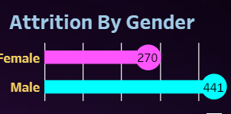
Attrition By Gender

Slide 6
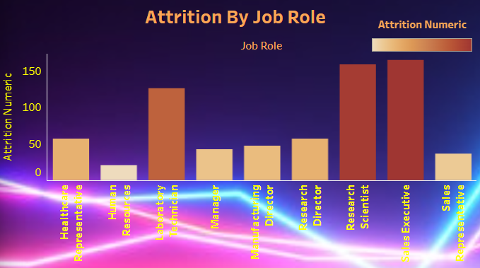
Attrition By Job Role

Slide 7
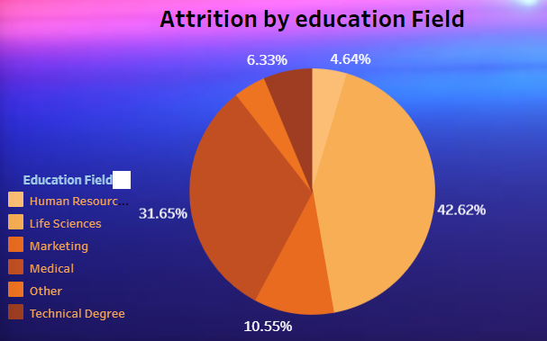
Attrition by Education field

Slide 8
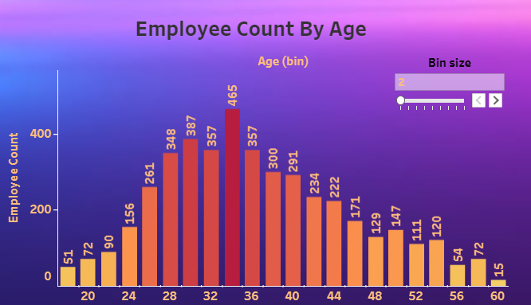
Employee count by age

Slide 9
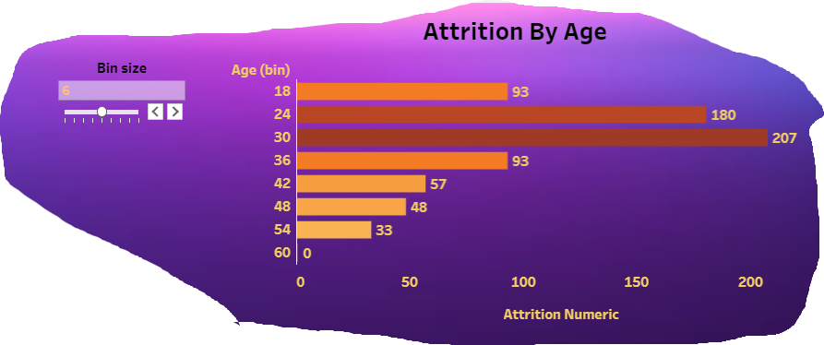
Attrition by age

Slide 10
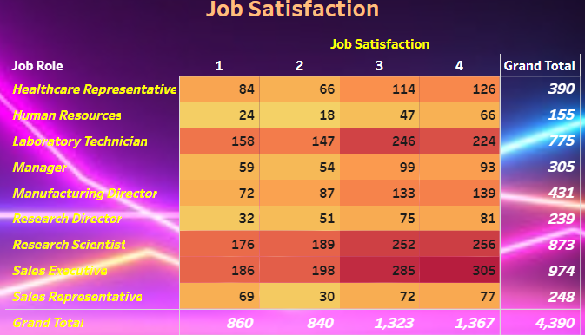
Job satisfaction

Slide 11
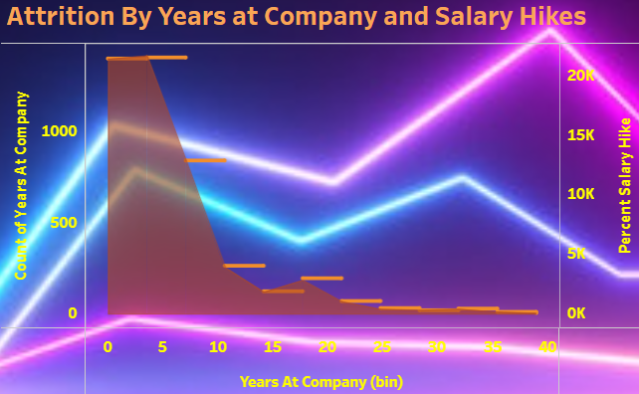

Attrition by years at company and salary hikes

Slide 12
Conclusion
The insights from this analysis illuminate critical aspects of employee attrition within the organization.
Understanding the factors contributing to attrition, including gender disparities, age-related trends, job satisfaction, and educational backgrounds, empowers HR strategies for retention and talent management.
Here is the tableau public link of my Dashboard: https://public.tableau.com/app/profile/lipsa.barik/viz/EmployeeattritionDahboard/EmployeeAttritionDashboard?publish=yes

Slide 13
THANK YOU

